Slide 1
Winter wheat varieties performance over years in variety trials in Switzerland
Nicolas Vuille-dit-Bille

Slide 2
Variety trial context
Winter wheat varieties are tested on different experimental fields across Switzerland
Each year, winter wheat varieties performance are reported and recommended to farmers according to a list
Challenge: not easy to predict specific varieties response to specific environment linked to abiotic and biotic stresses

Slide 3
Case study: variety trial with 2 modalities over years
36 winter wheat varieties
4 years: 2021 to 2024
Case study context: study variety response to none vs conventional application
Find variety that are performing well also under limited available N in order to reduce N fertilization (economic and environmental cost)
2 treatments: conventional application of nitrogen (N) and no application of nitrogen
Measurement to estimate varieties performance:
Grain yield
Straw yield
Grain protein
Other physiological parameters (harvest index, leaf area index, chlorophyll content, canopy cover…)

Slide 4
Case study: experimental design
2 blocks corresponding to 2 treatments (conventional and no N treatment) within field
3 replicates of varieties by block
4 climatic conditions over 4 years
YEAR
2021
2022
2023
2024
N treatment
N conventional
N0
N conventional
N0
N conventional
N0
N conventional
N0
N reduced
Variety
36 varieties
(3 rep)
36 varieties
(3 rep)
36 varieties
(3 rep)
36 varieties
(3 rep)
36 varieties
(3 rep)
36 varieties
(3 rep)
36 varieties
(3 rep)
36 varieties
(3 rep)
36 varieties
(3 rep)

Slide 5
Data preparation
The varieties tested are not always the same over years
Find common varieties tested over 4 years
The measurements to evaluate the variety performance are not always the same over years
Find common variables measured over 4 years
Due to experimental issue some values are lost and one replicate less can imbalance the statistical analysis (especially with rep=3)
Remove varieties with not sufficient replicates
Datasets are stored by years on excel sheet
Merge datasets for over years analysis and visualisation

Slide 6
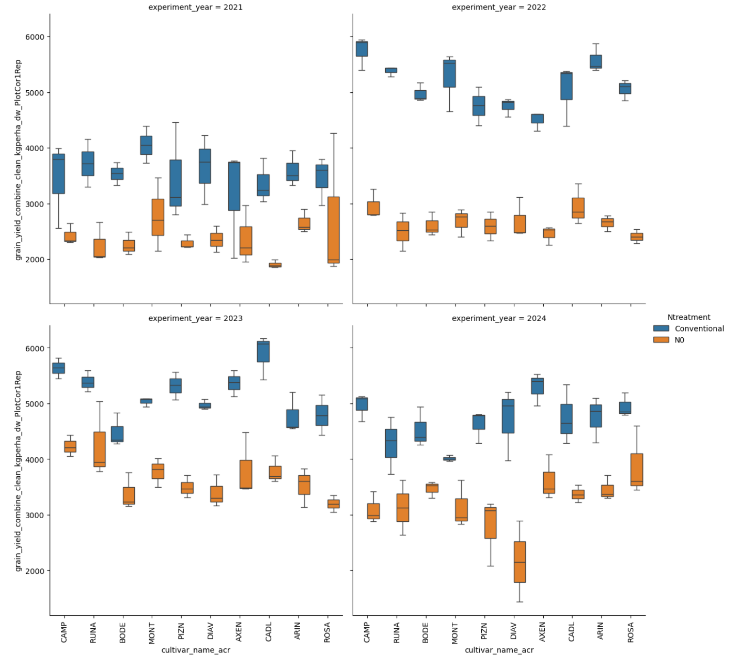
Estimate statistical differences: grain yield

Slide 7
Model parameters
Response variable: grain yield
3 factors can be considered as explanatory variables:
Varieties : 10 levels
N treatment: 2 levels (N0, Conventional)
Years: 4 levels

Slide 8
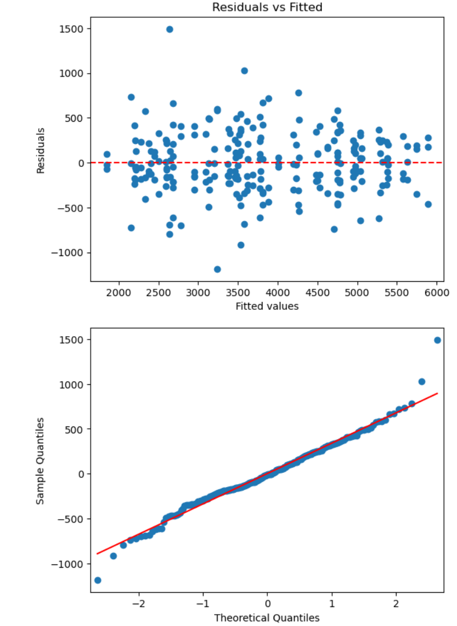
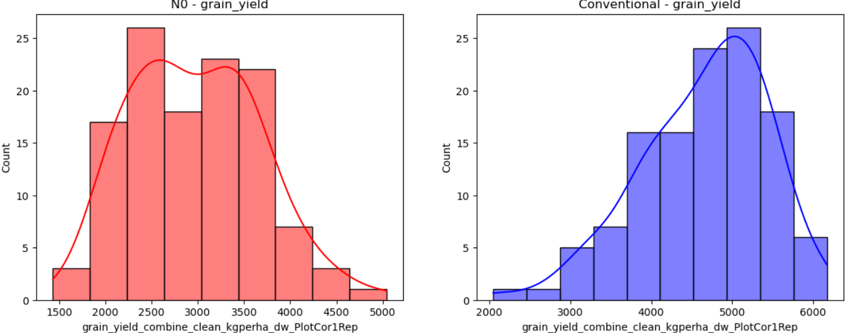
Statistical test options: ANOVA
0.0066
Model assumption:
Independence of Observations
Normality
Homogeneity of Variances (Homoscedasticity)
Additivity
Fixed Effects
Shapiro-Wilk test p-value: 0.0067

Slide 9
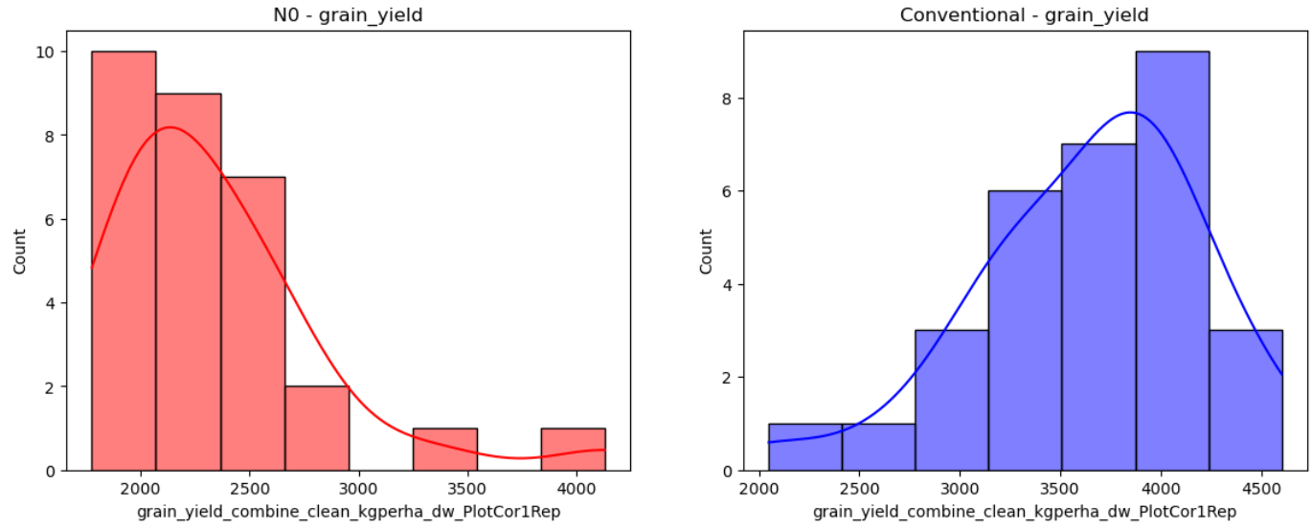
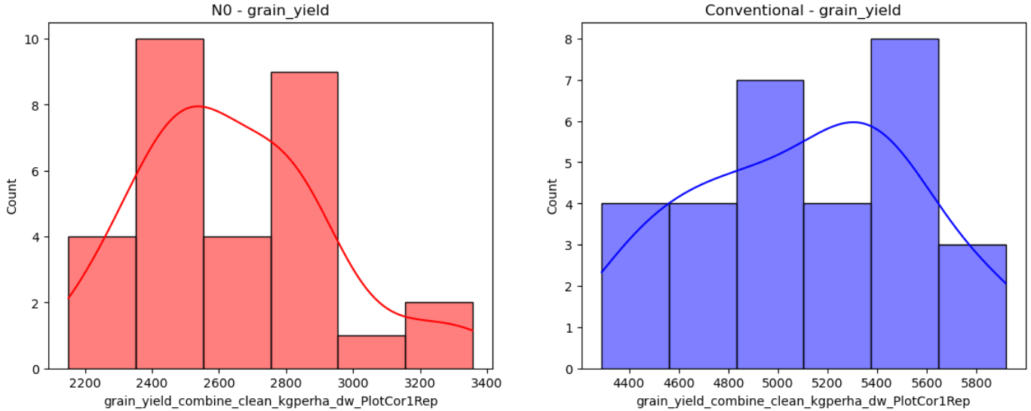
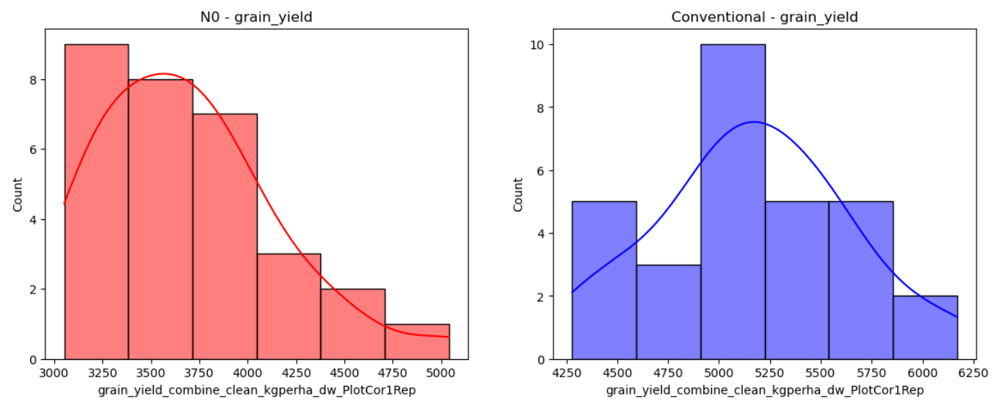
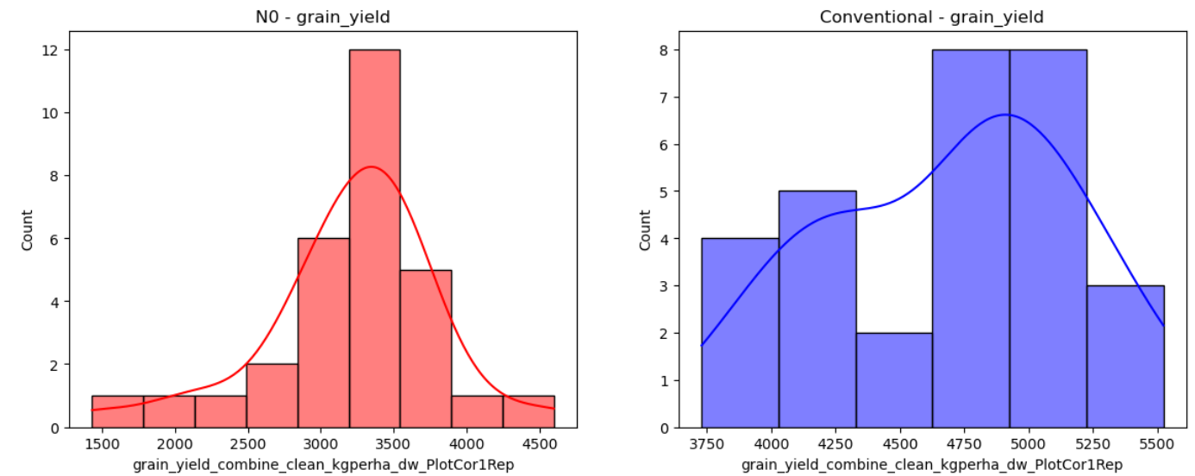
Data distribution by N treatment blocks and years
2021
2022
2023
2024

Slide 10
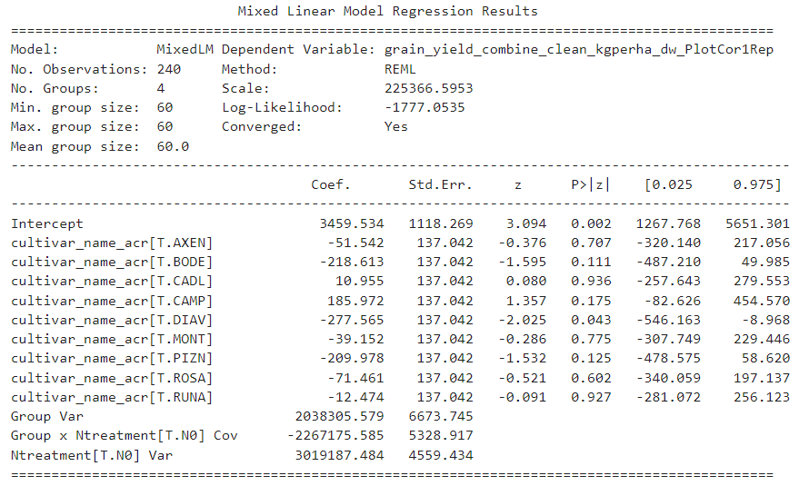
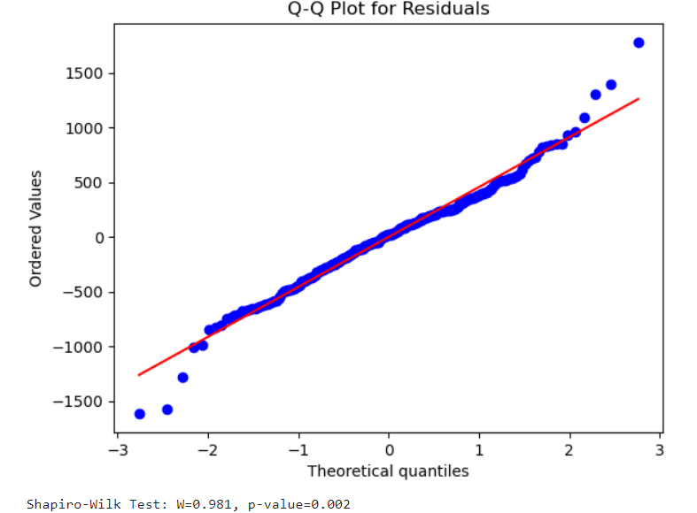
Linear mixed model
Handles lack of independence of observations
Fixed effects: genotypes
Random effects: N treatments nested in years factor
(account for correlation between observations within the same treatment block)
Python formula:
Model = smf.mixedlm("grain_yield_combine_clean_kgperha_dw_PlotCor1Rep ~ cultivar_name_acr", data=merged_df, groups=merged_df["experiment_year"], re_formula="1 + Ntreatment")
Normality of residuals ?

Slide 11
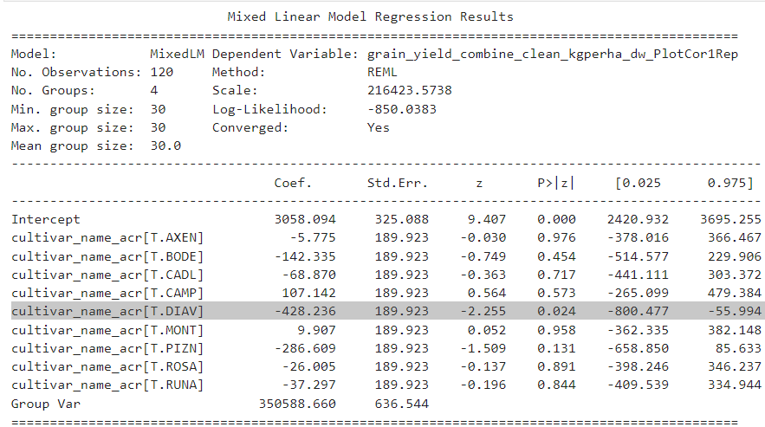
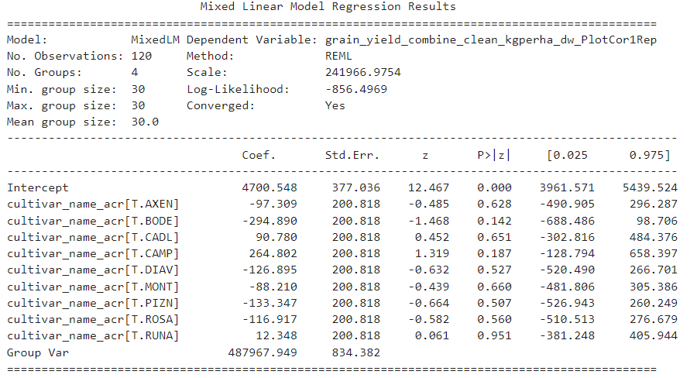
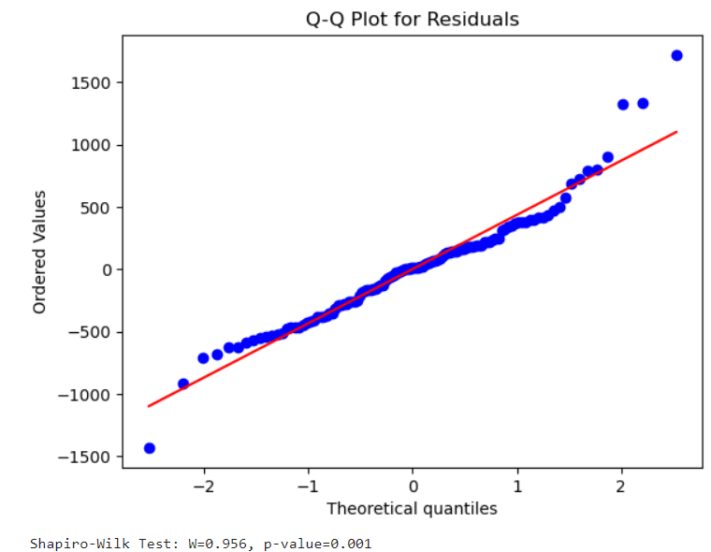
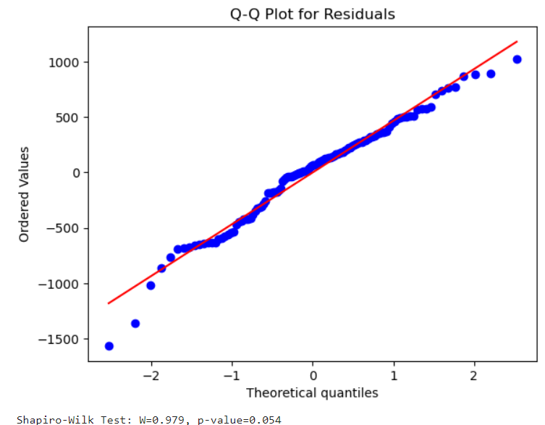
Fit linear mixed models for each N treatments
A lot of variability seems not explained by the fixed effects (year effect)
At this level, no significant differences between varieties are found
Let’s explore if there are significant variety differences within each year and within each N treatment block
N0
Conventional N

Slide 12
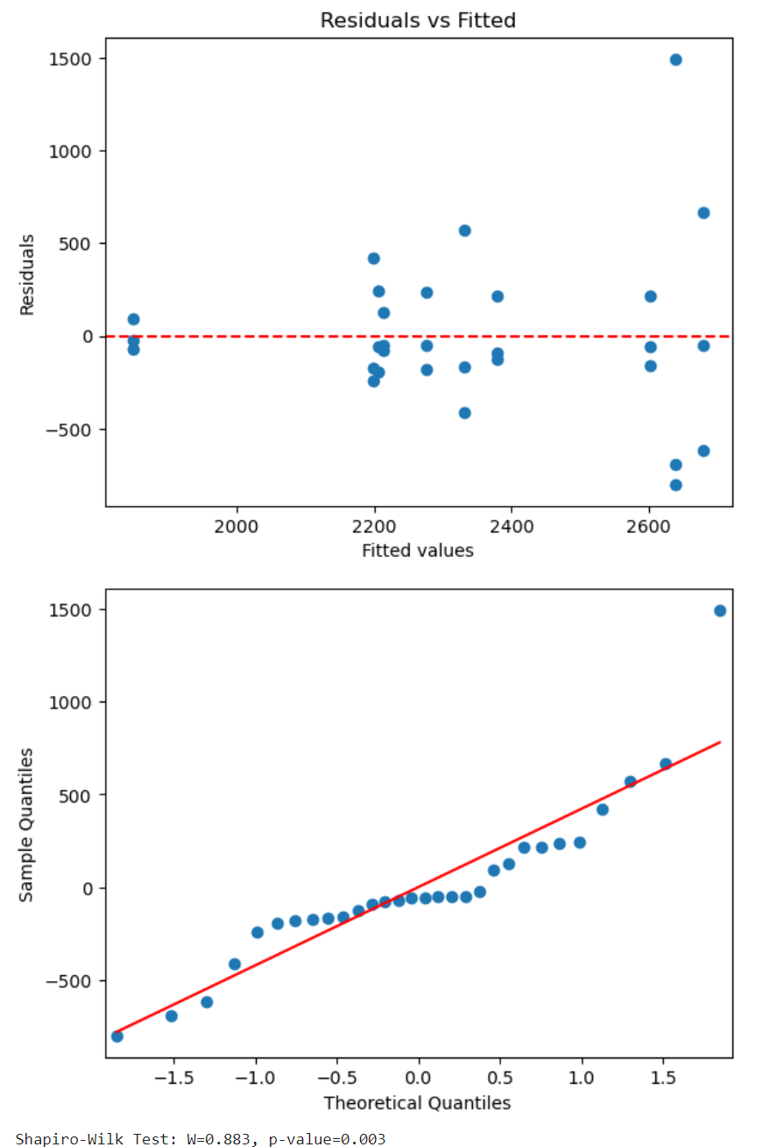
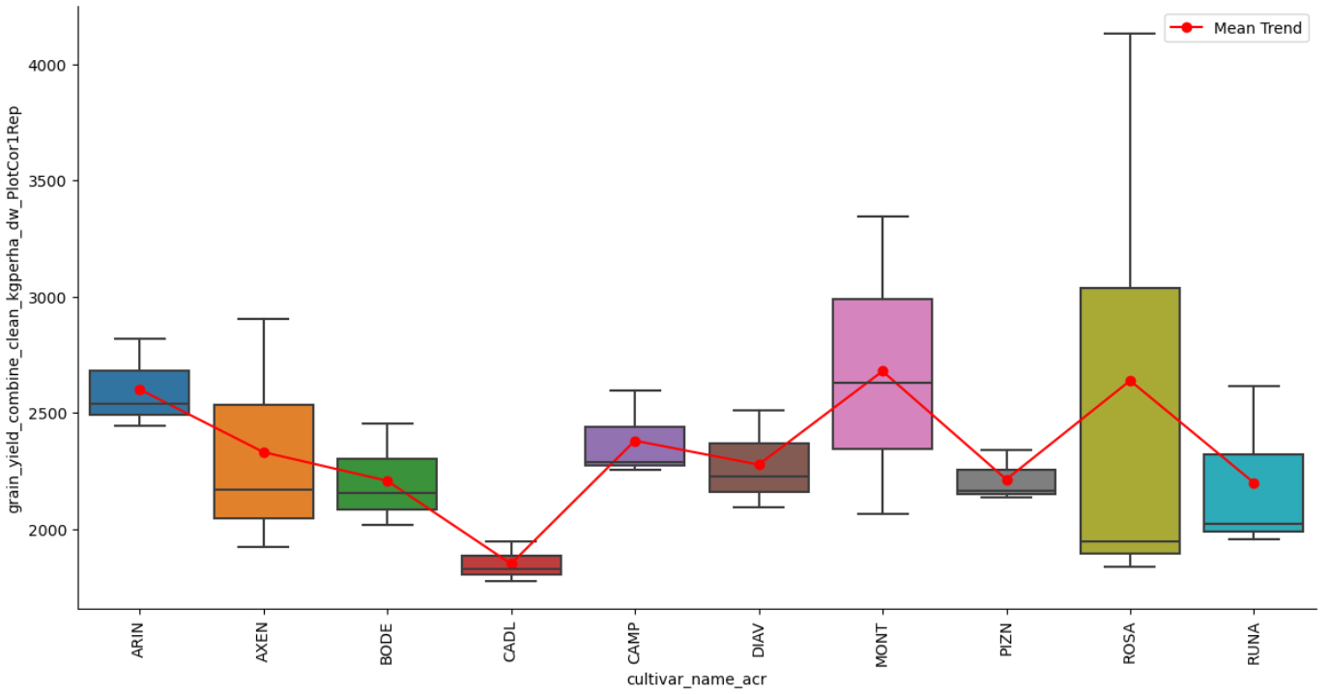
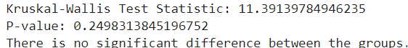
N0 analysis: 2021

Slide 13
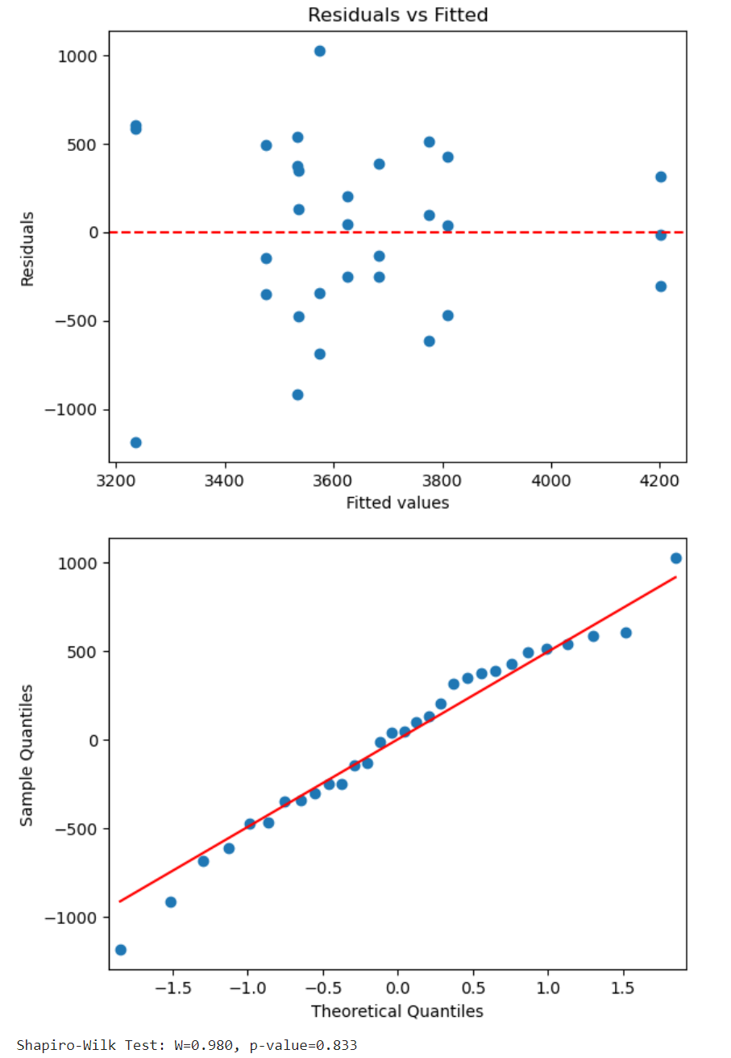
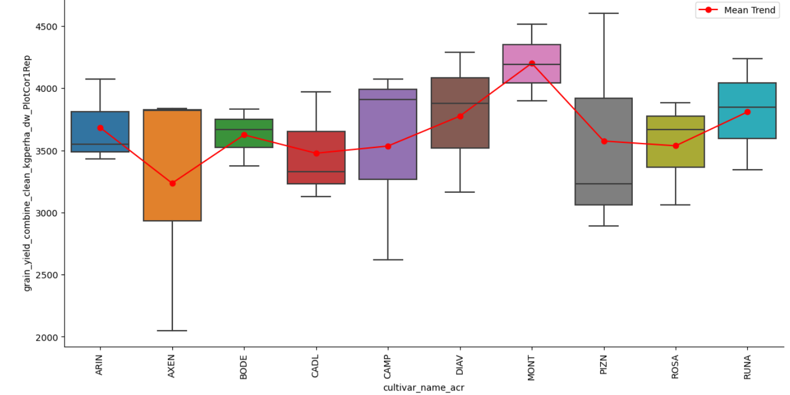
Conventional N analysis: 2021

Slide 14
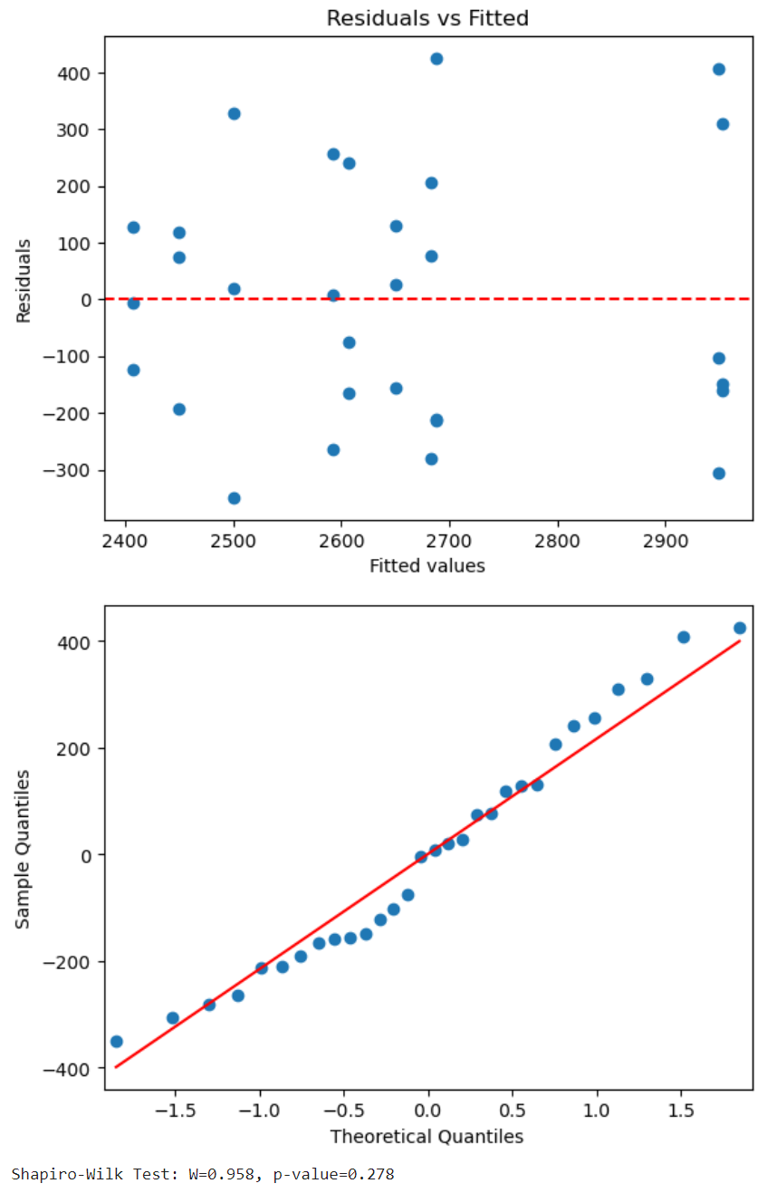
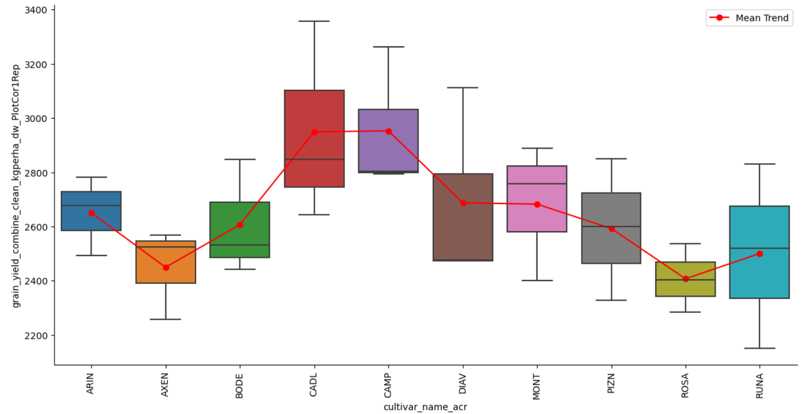
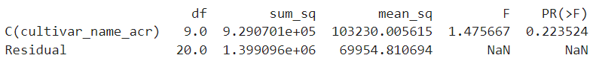
N0 analysis: 2022

Slide 15
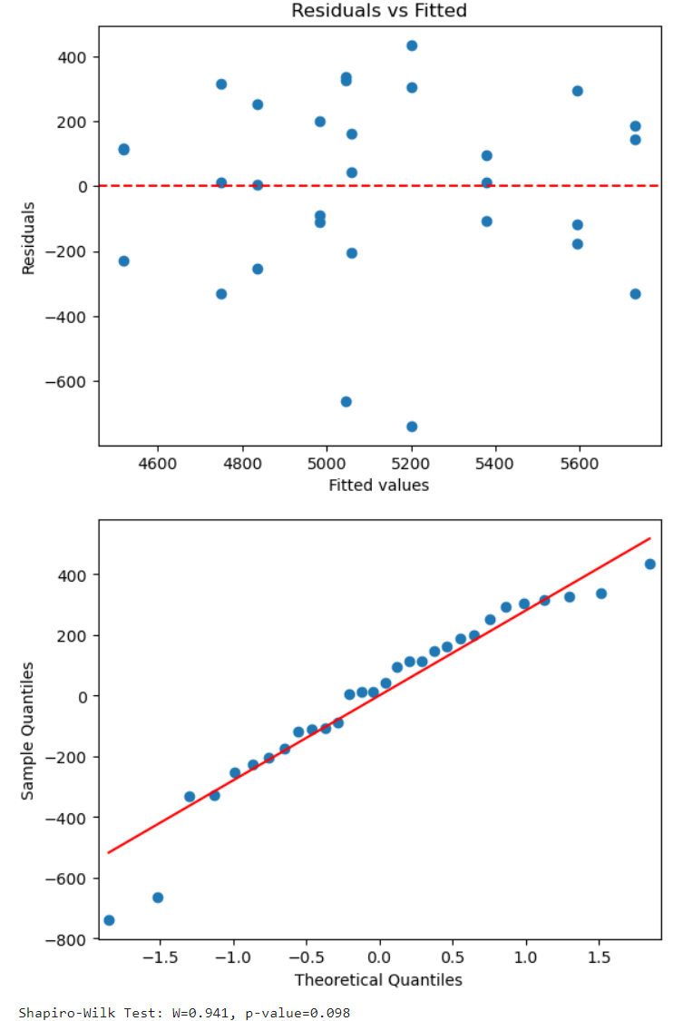
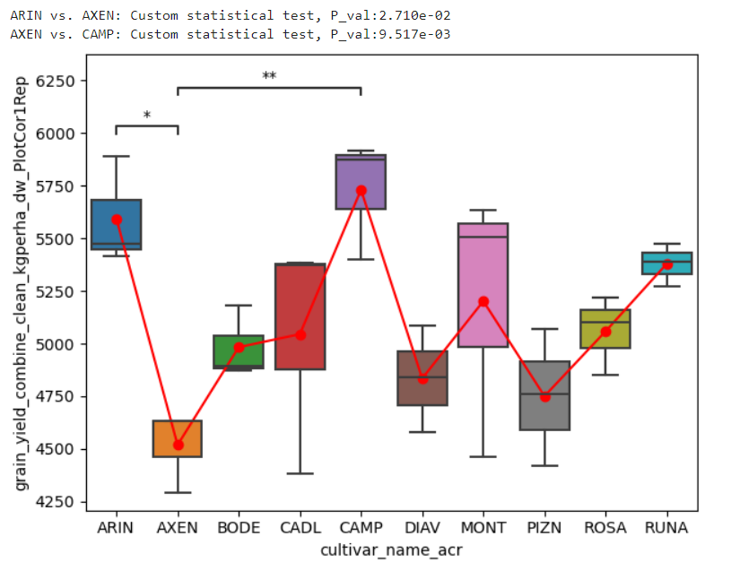
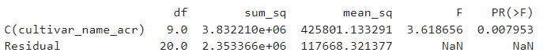
Conventional N analysis: 2022

Slide 16
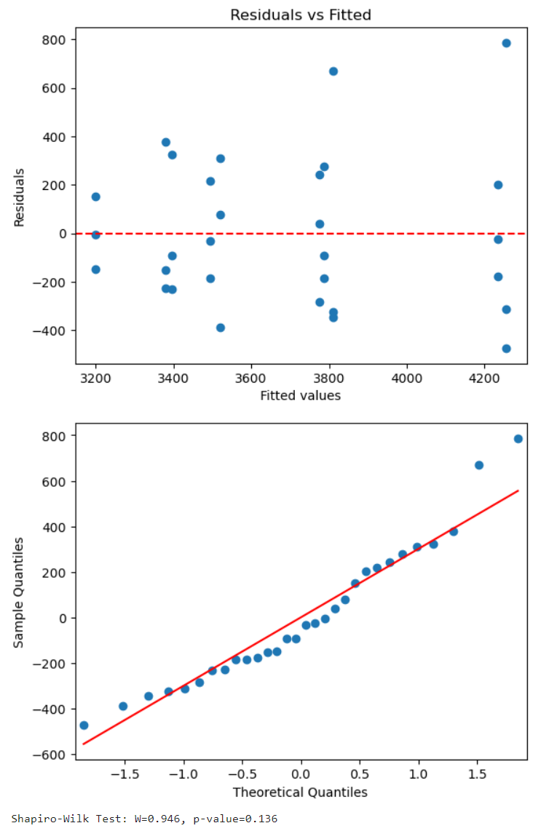
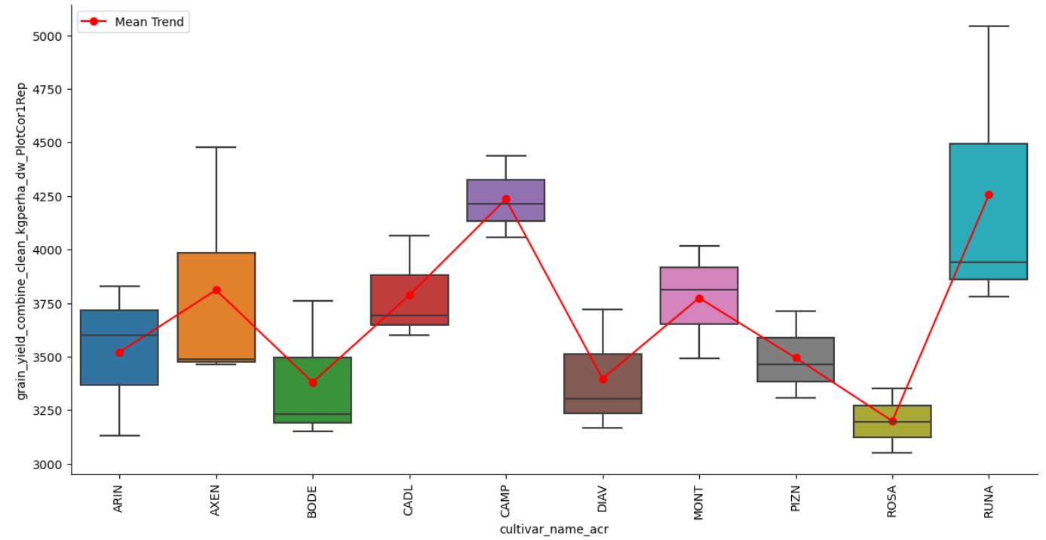
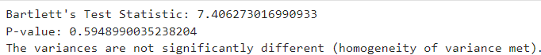
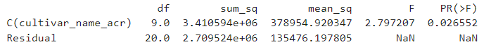
N0 analysis: 2023

Slide 17
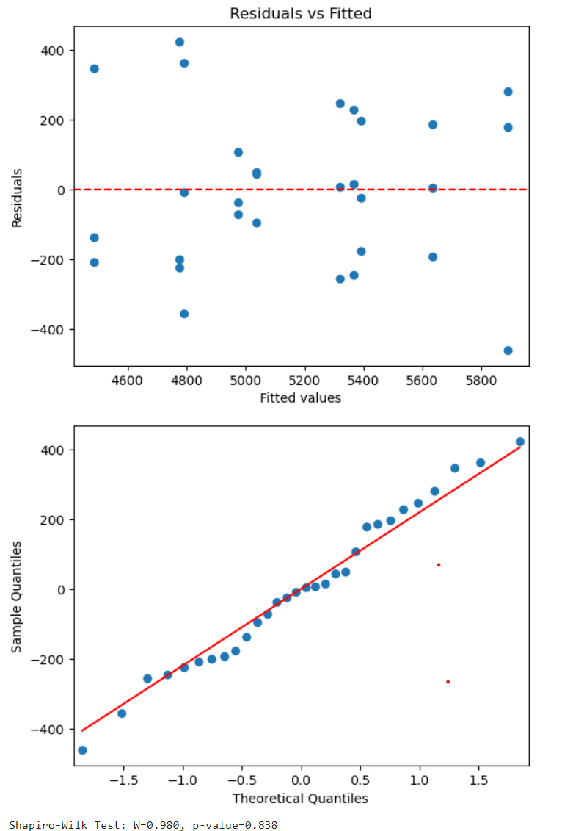
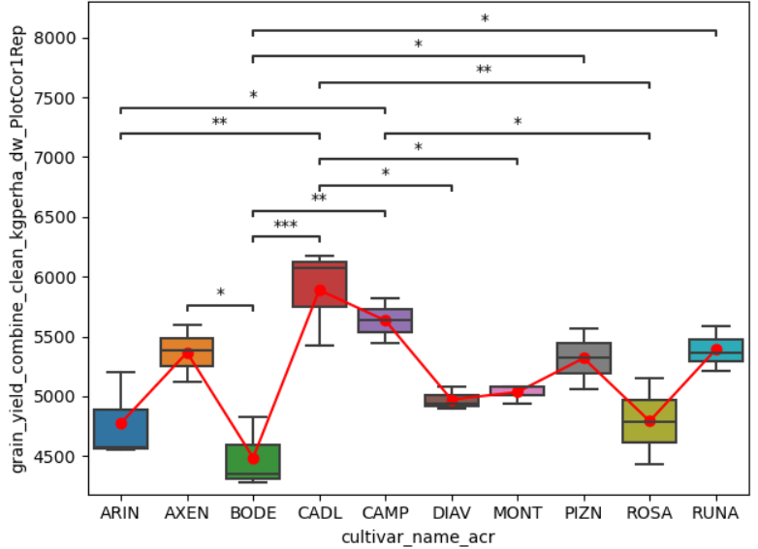
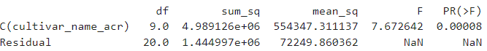
Conventional N analysis: 2023

Slide 18
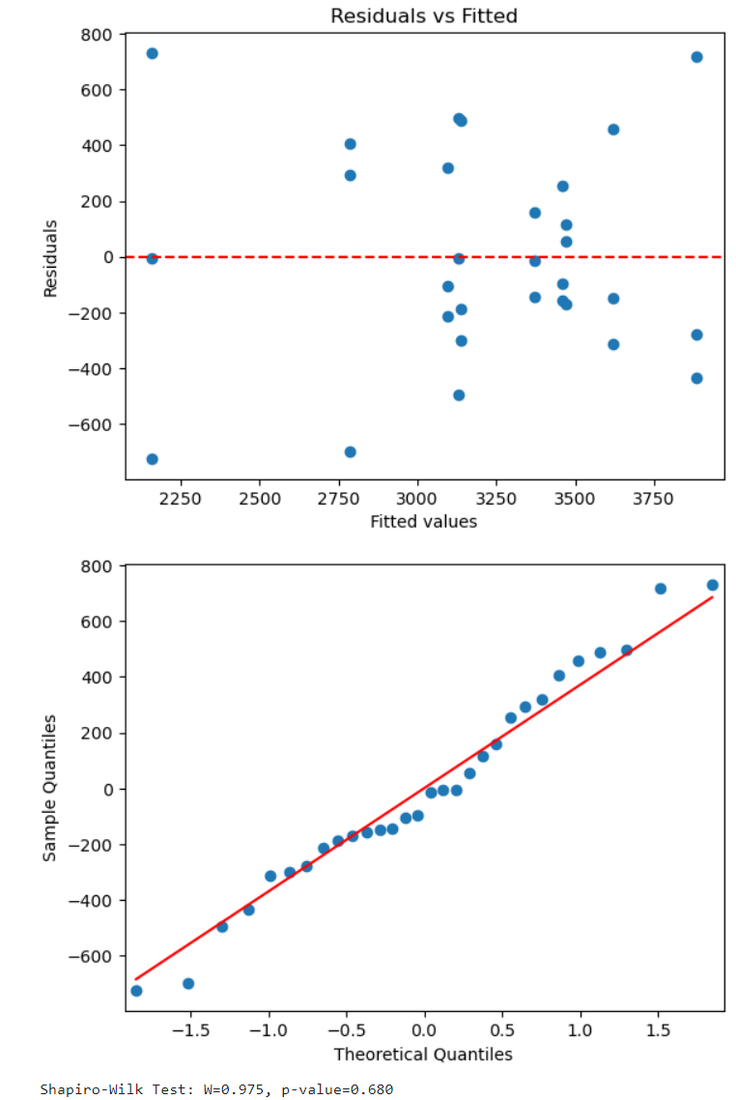
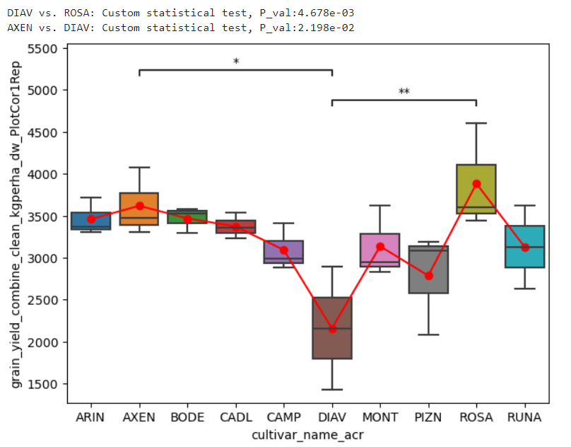
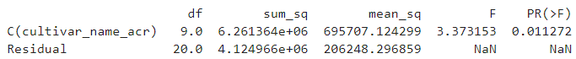
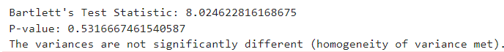
N0 analysis: 2024

Slide 19
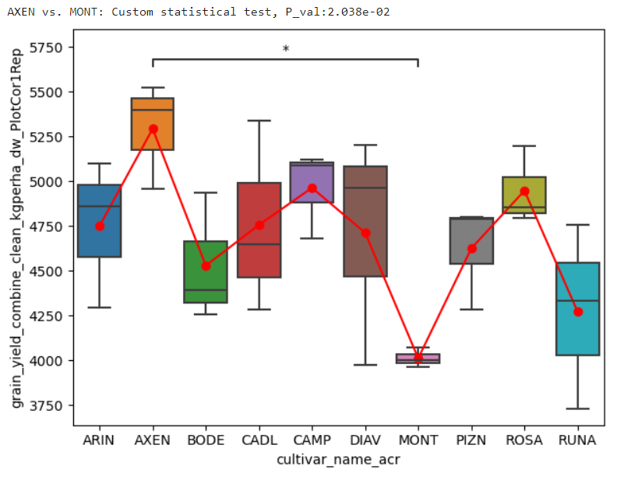
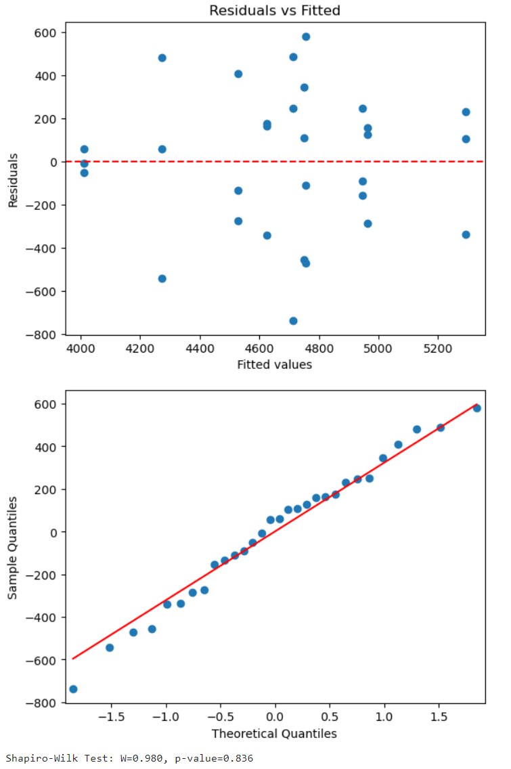
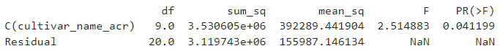
Conventional N analysis: 2024

Slide 20
Summary: statistical differences between varieties
Conventional N - 2022
Conventional N - 2023
2021: grain yield too low – no significant differences found between varieties in both N treatment block.
N0: no significant differences found, except in 2024.
Campesino variety: consistent high grain yield over years and significantly different from other varieties.
Axen variety: high grain yield over years with significant differences from other varieties but sensible to rainy weather condition (2021).
N0 - 2024
Conventional N - 2024

Slide 21
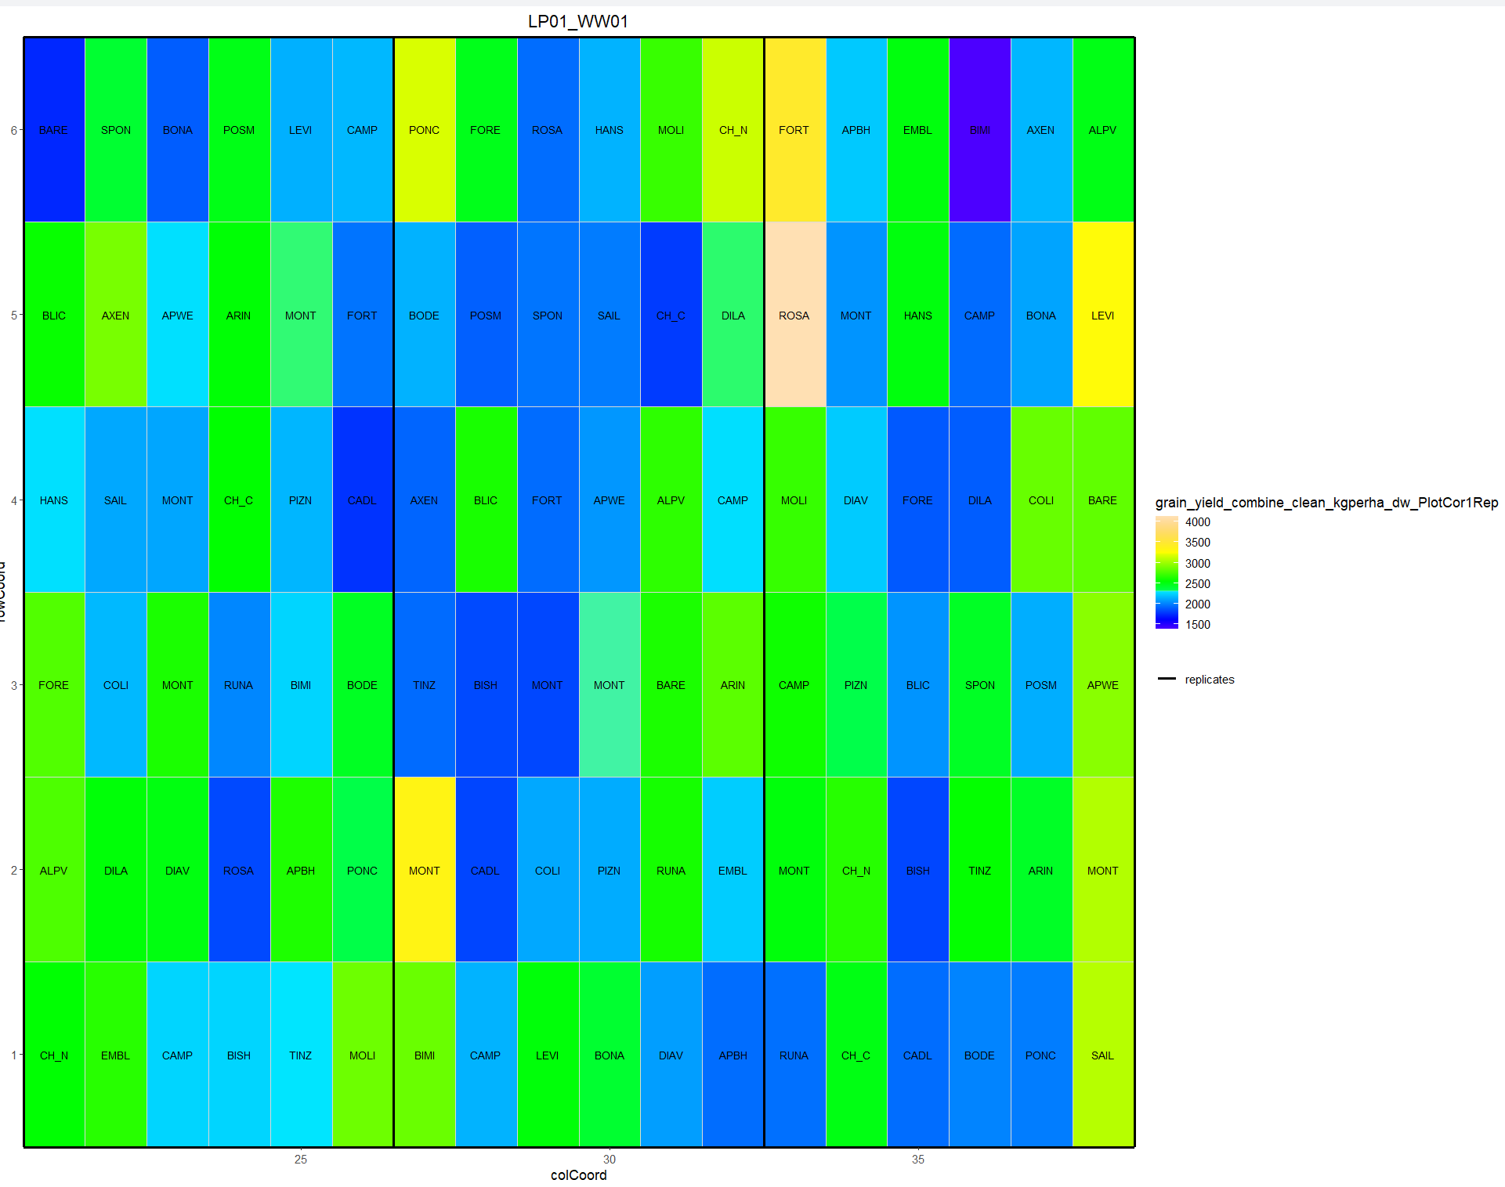
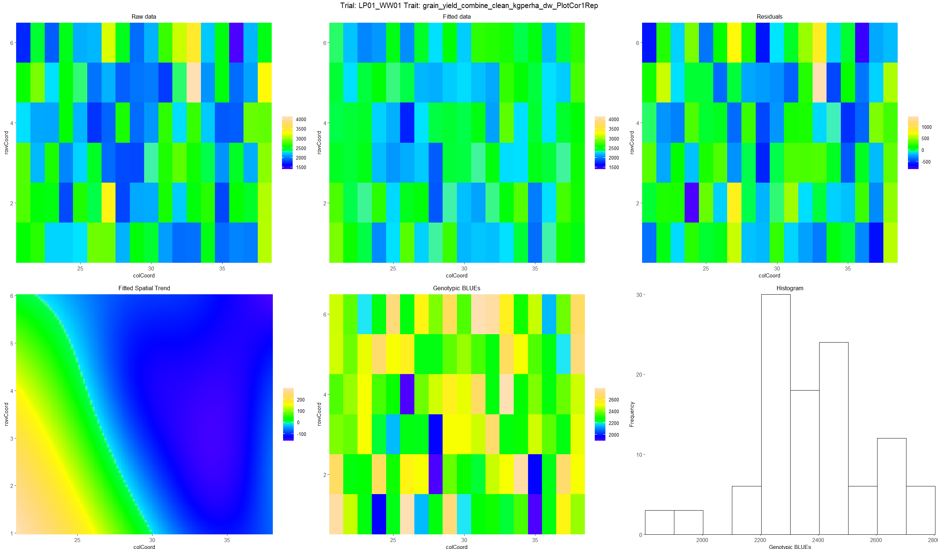
N0 – 2021- h2 = 0 (0)

Slide 22
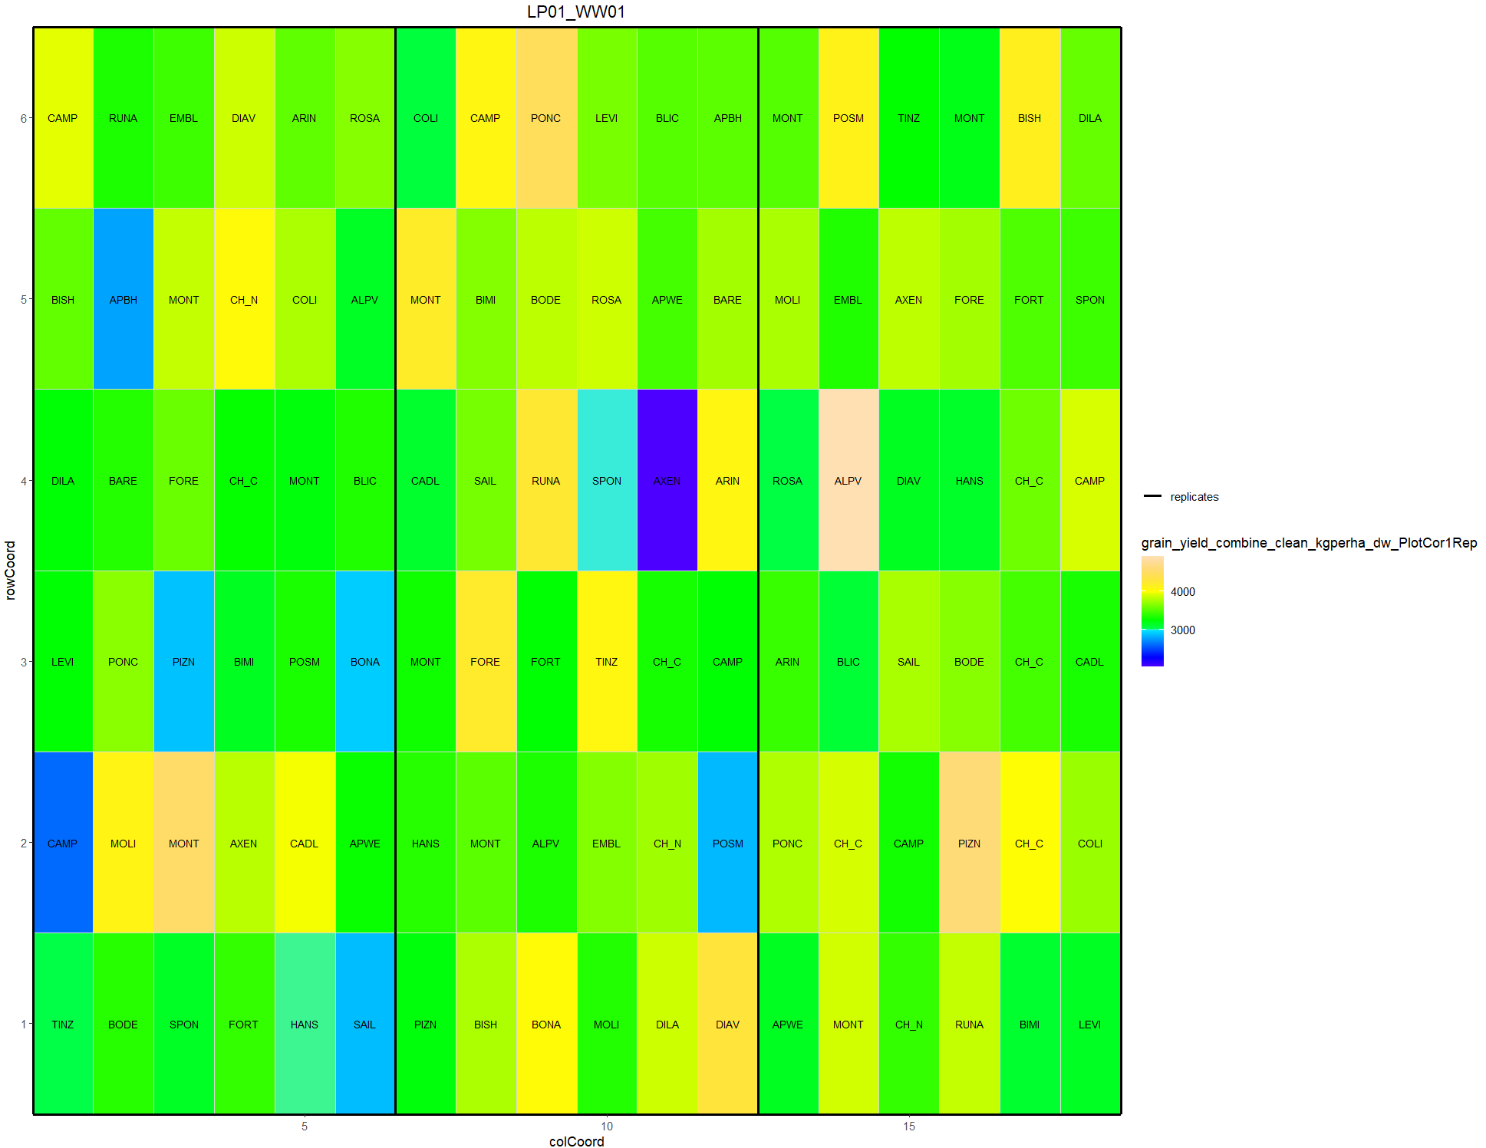
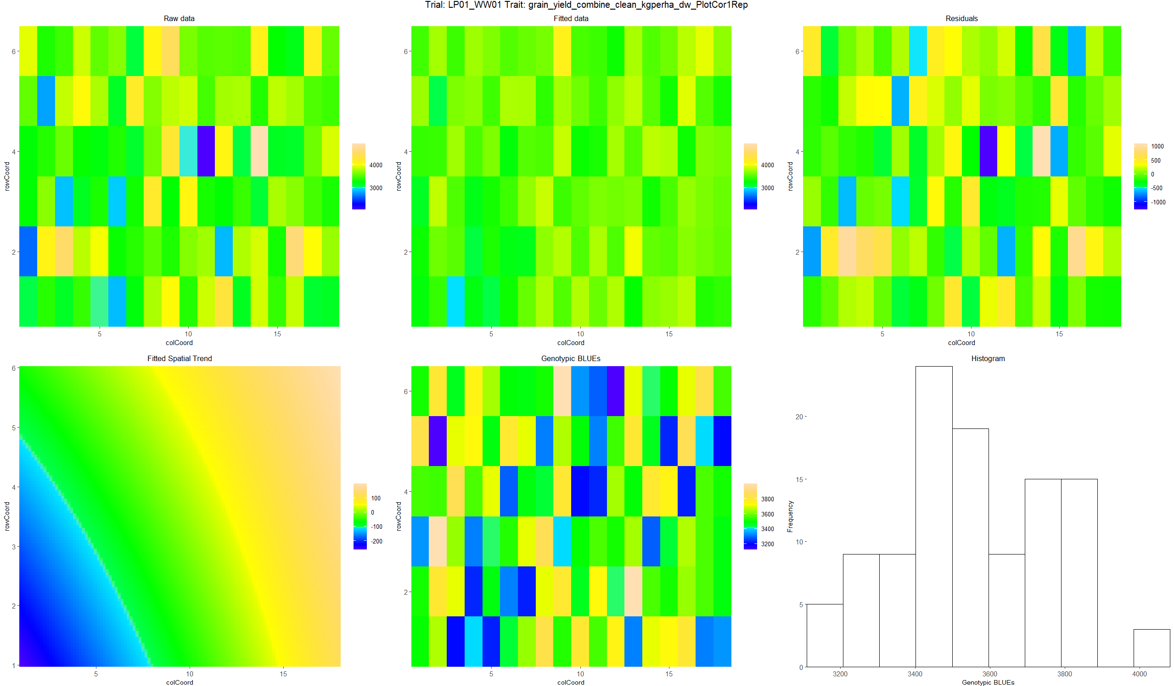
Conventional N – 2021- h2 = 0 (0)

Slide 23
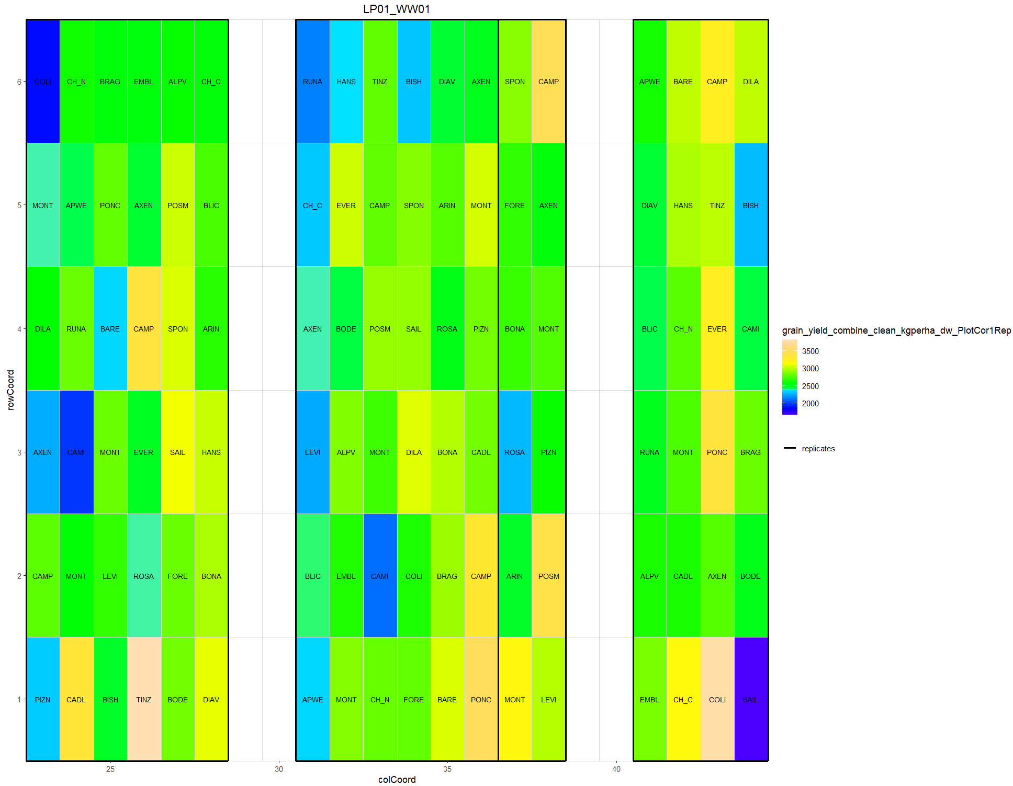
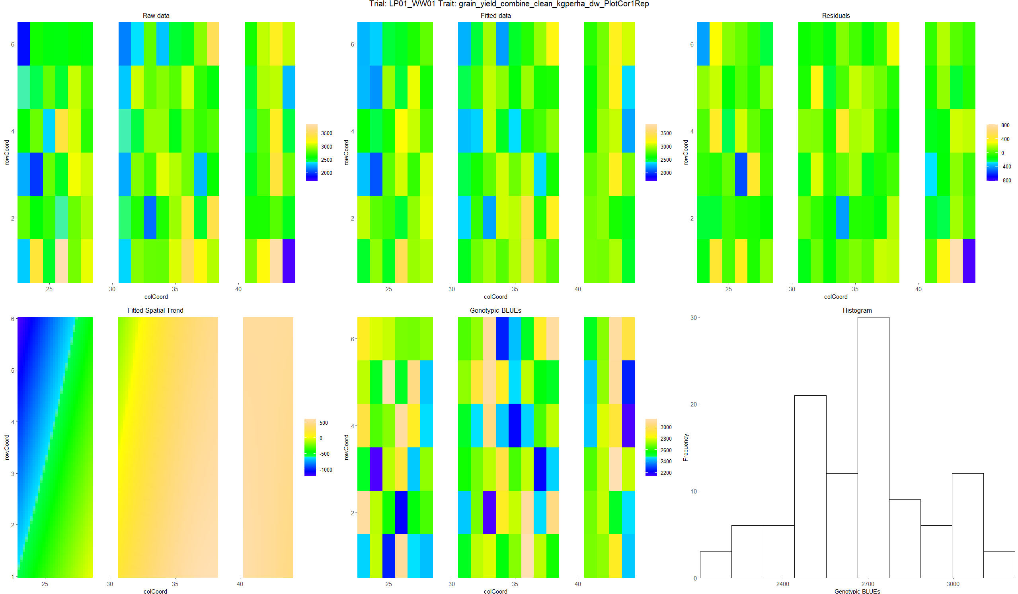
N0 – 2022- h2 = 0.61 (0.89: 10 Var)

Slide 24
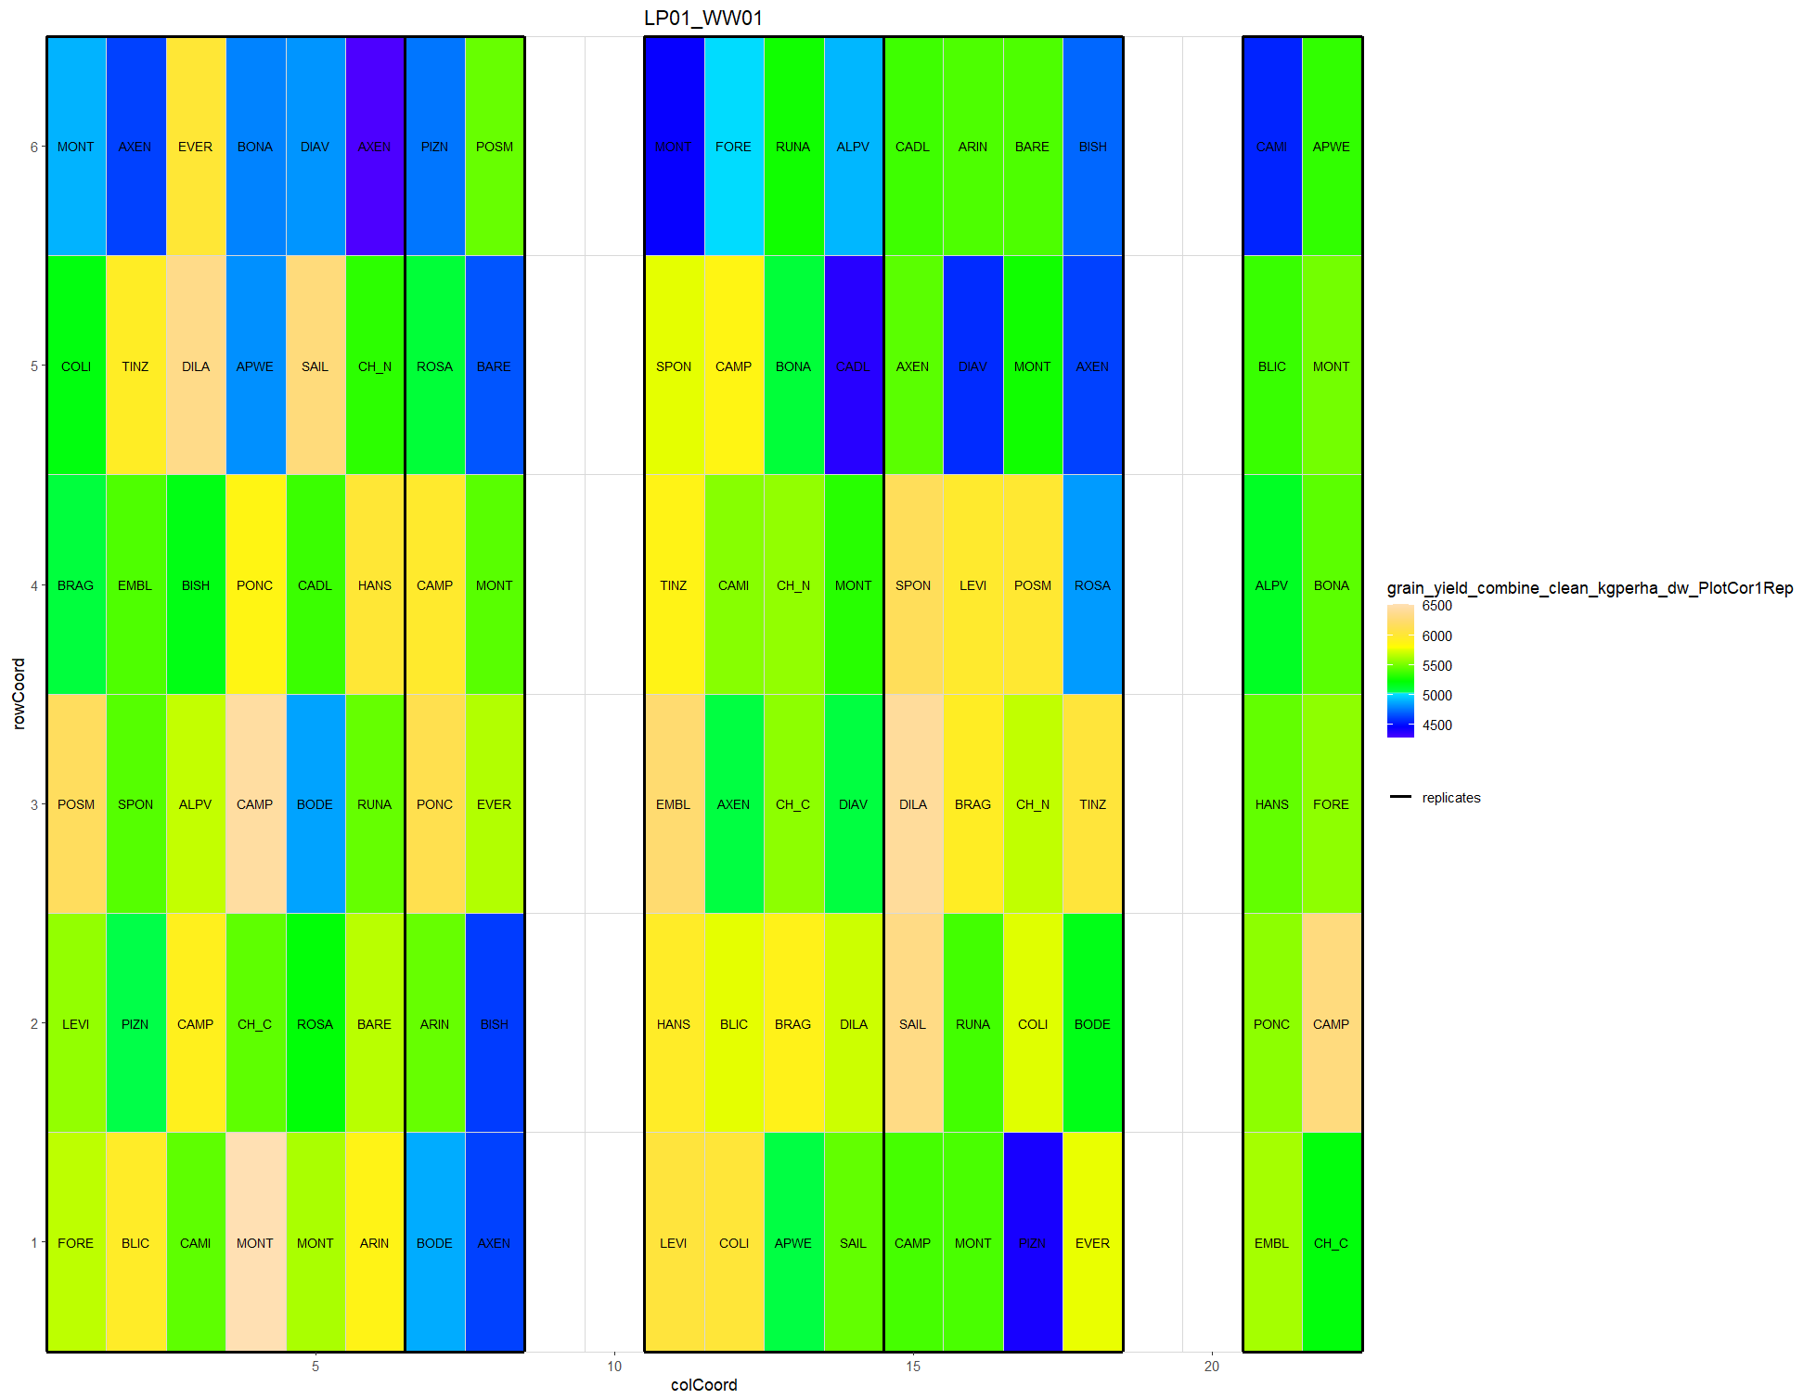
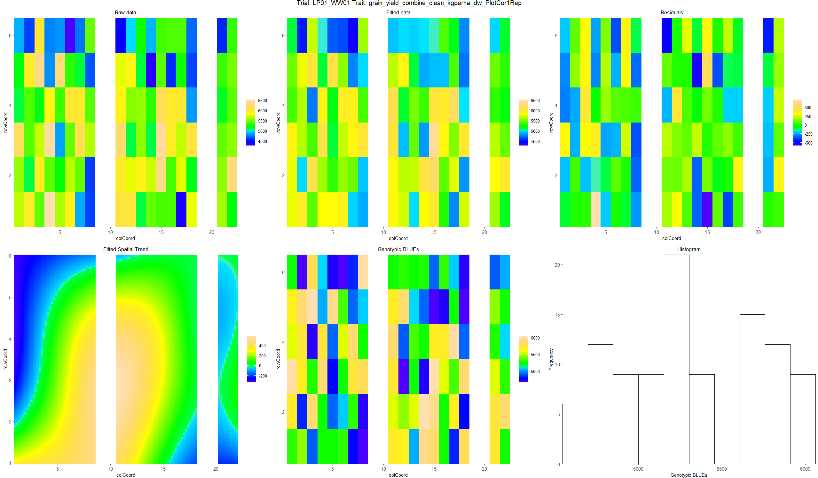
Conventional N – 2022 – h2 = 0.87 (0.85: 10 Var)

Slide 25
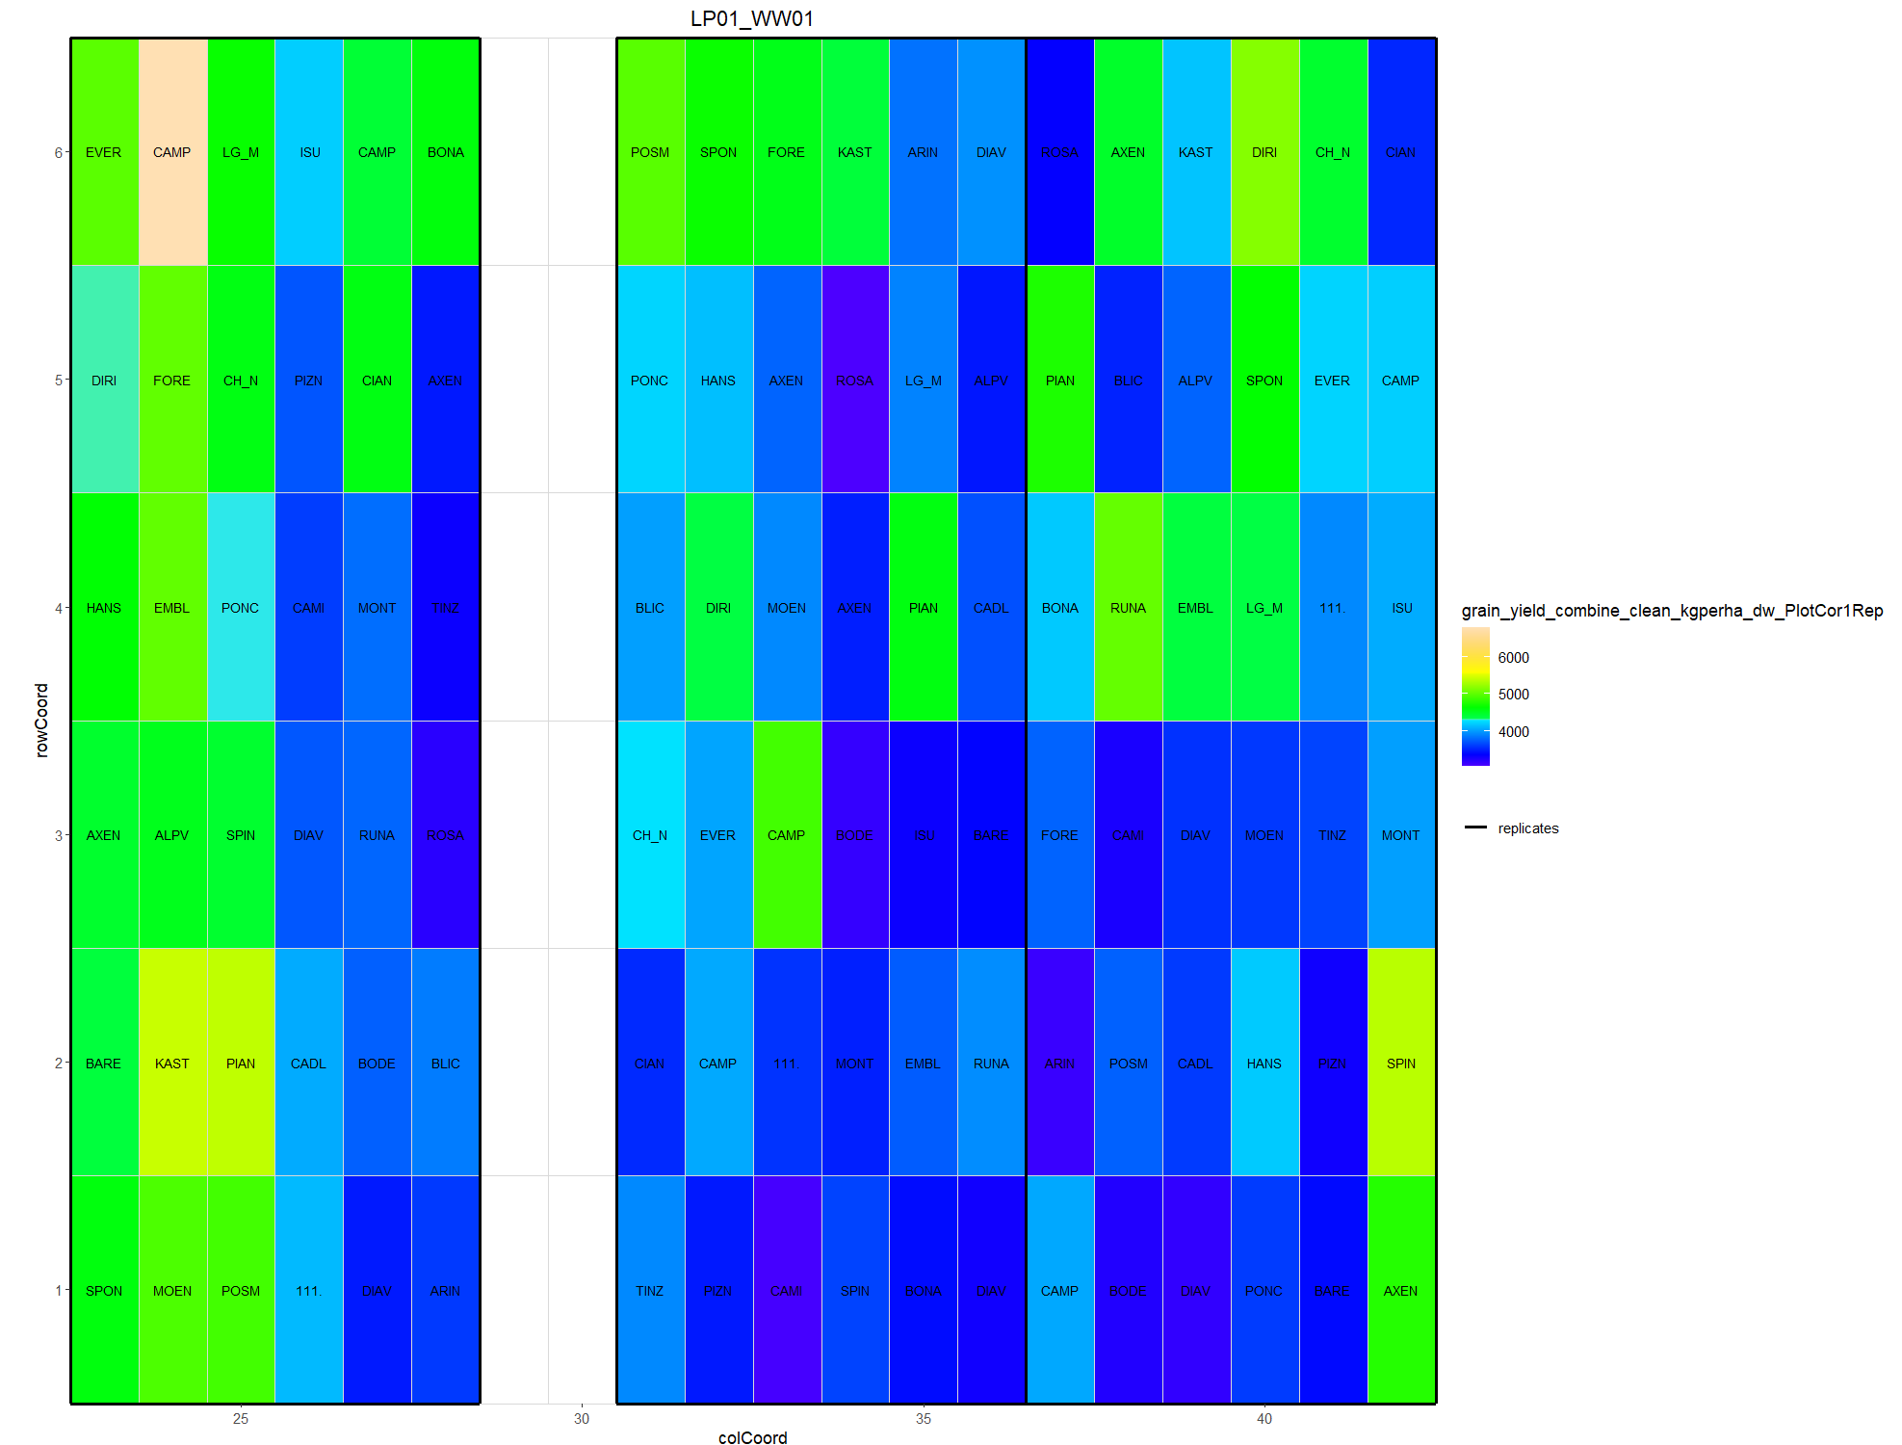
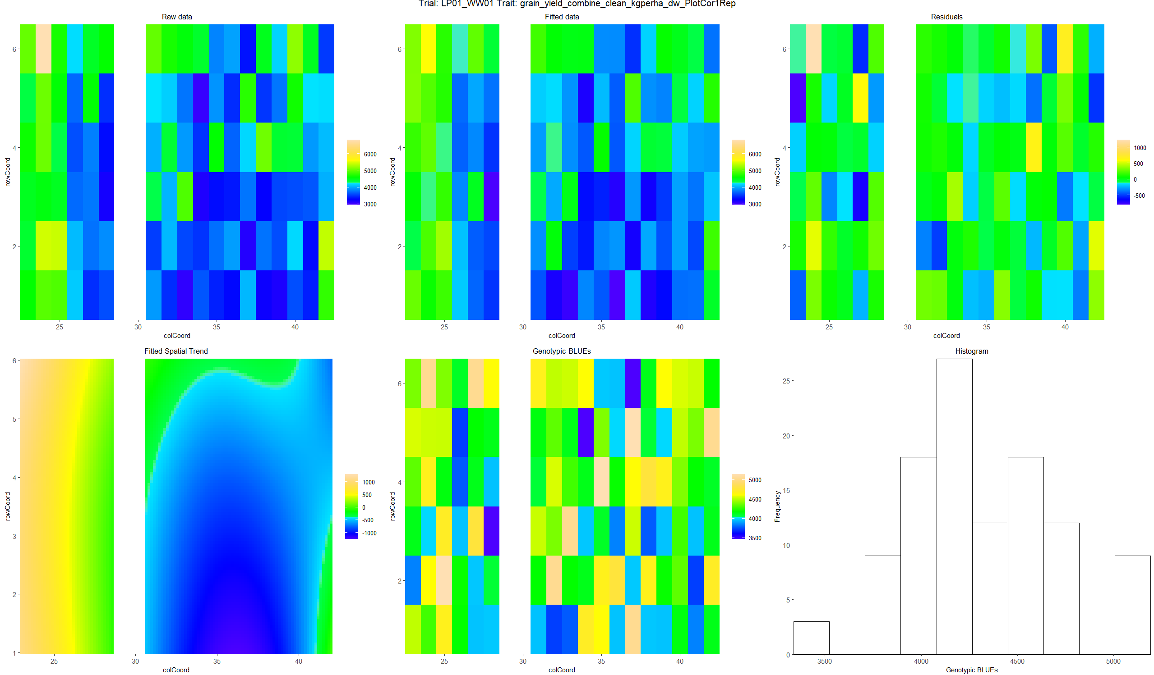
N0 – 2023 – h2 = 0.79 (0.75: without plot cor; 0.88: 10 Var )

Slide 26
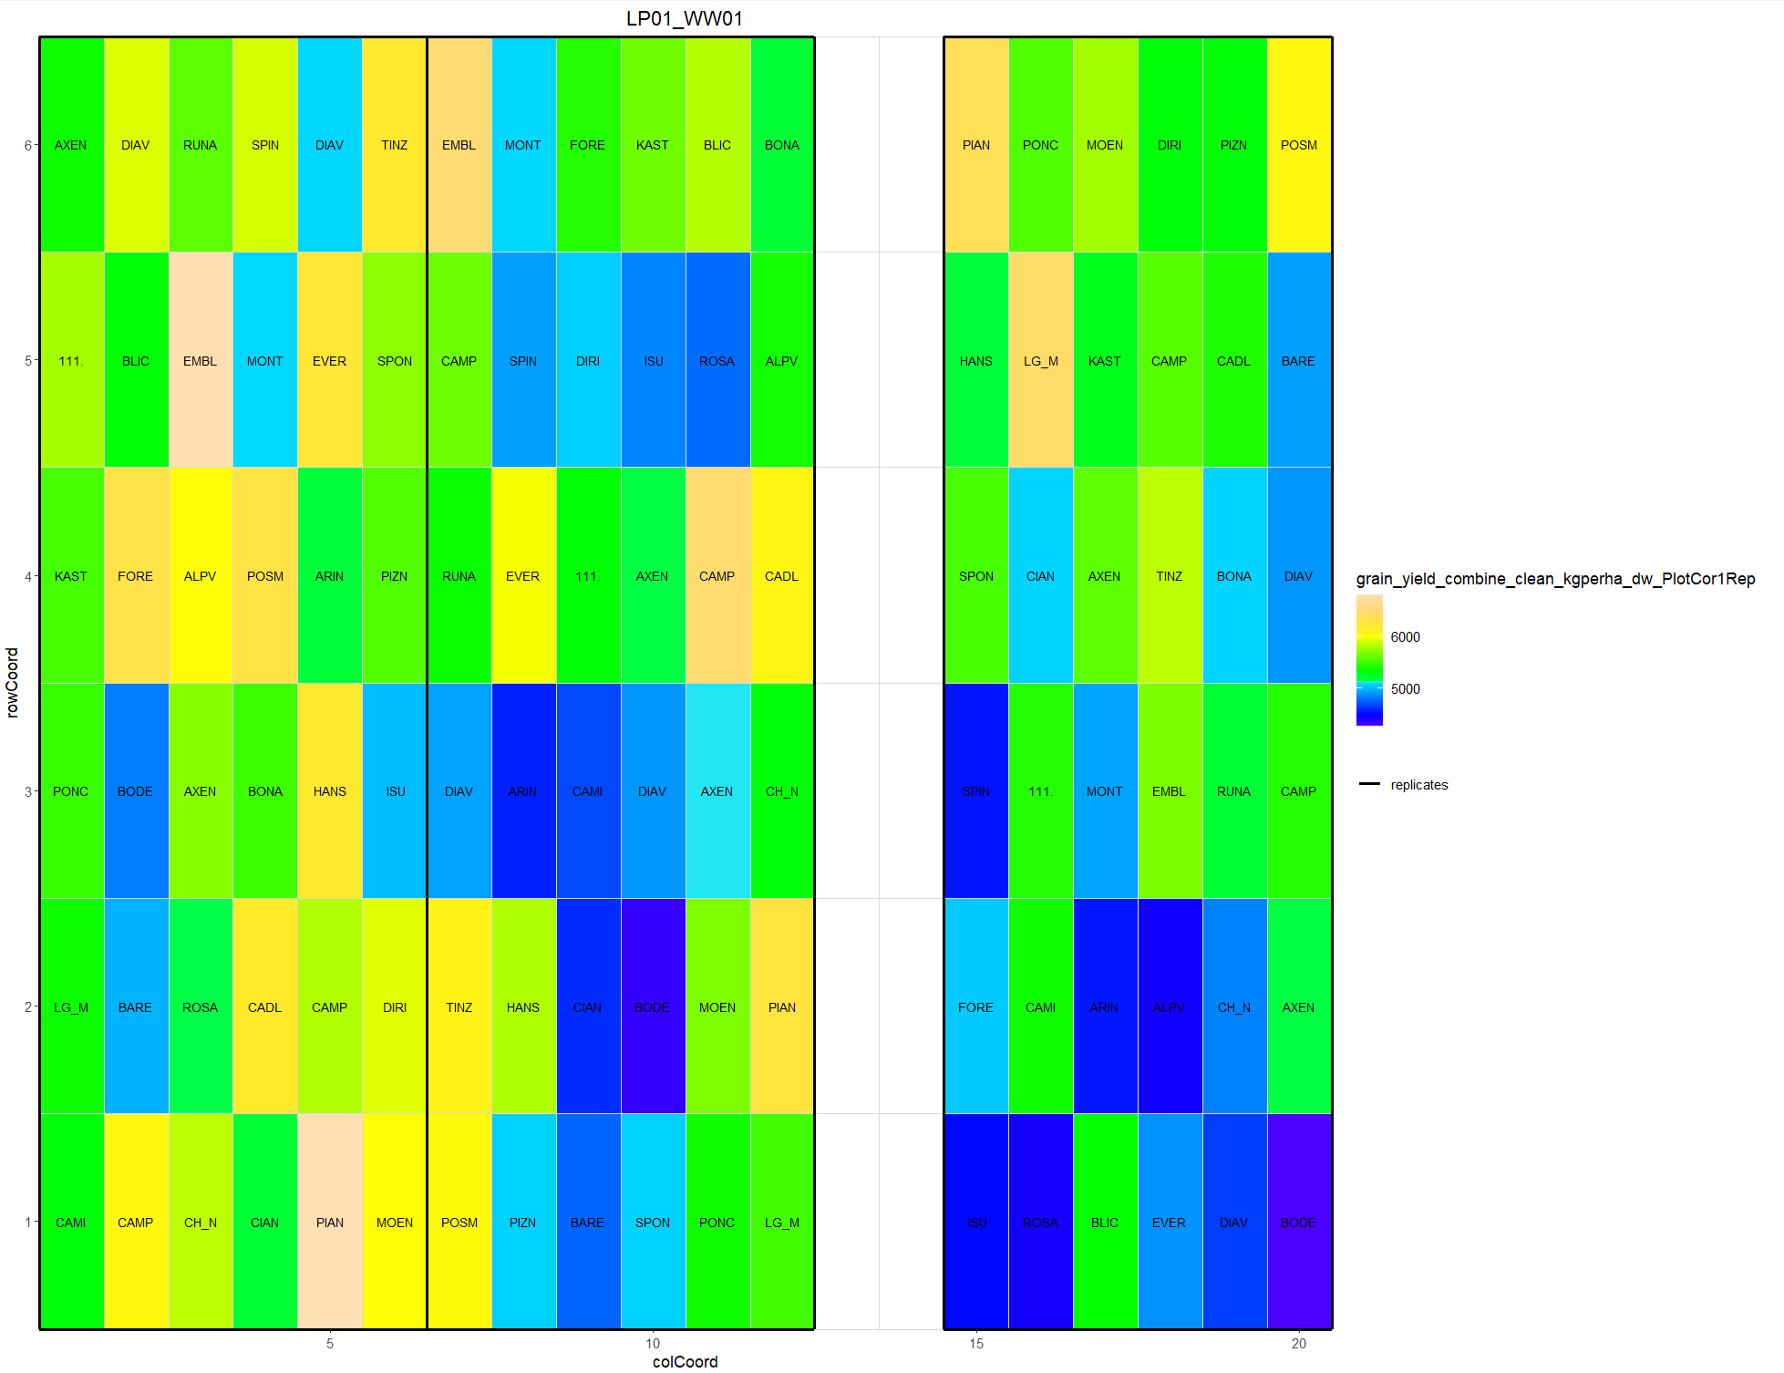
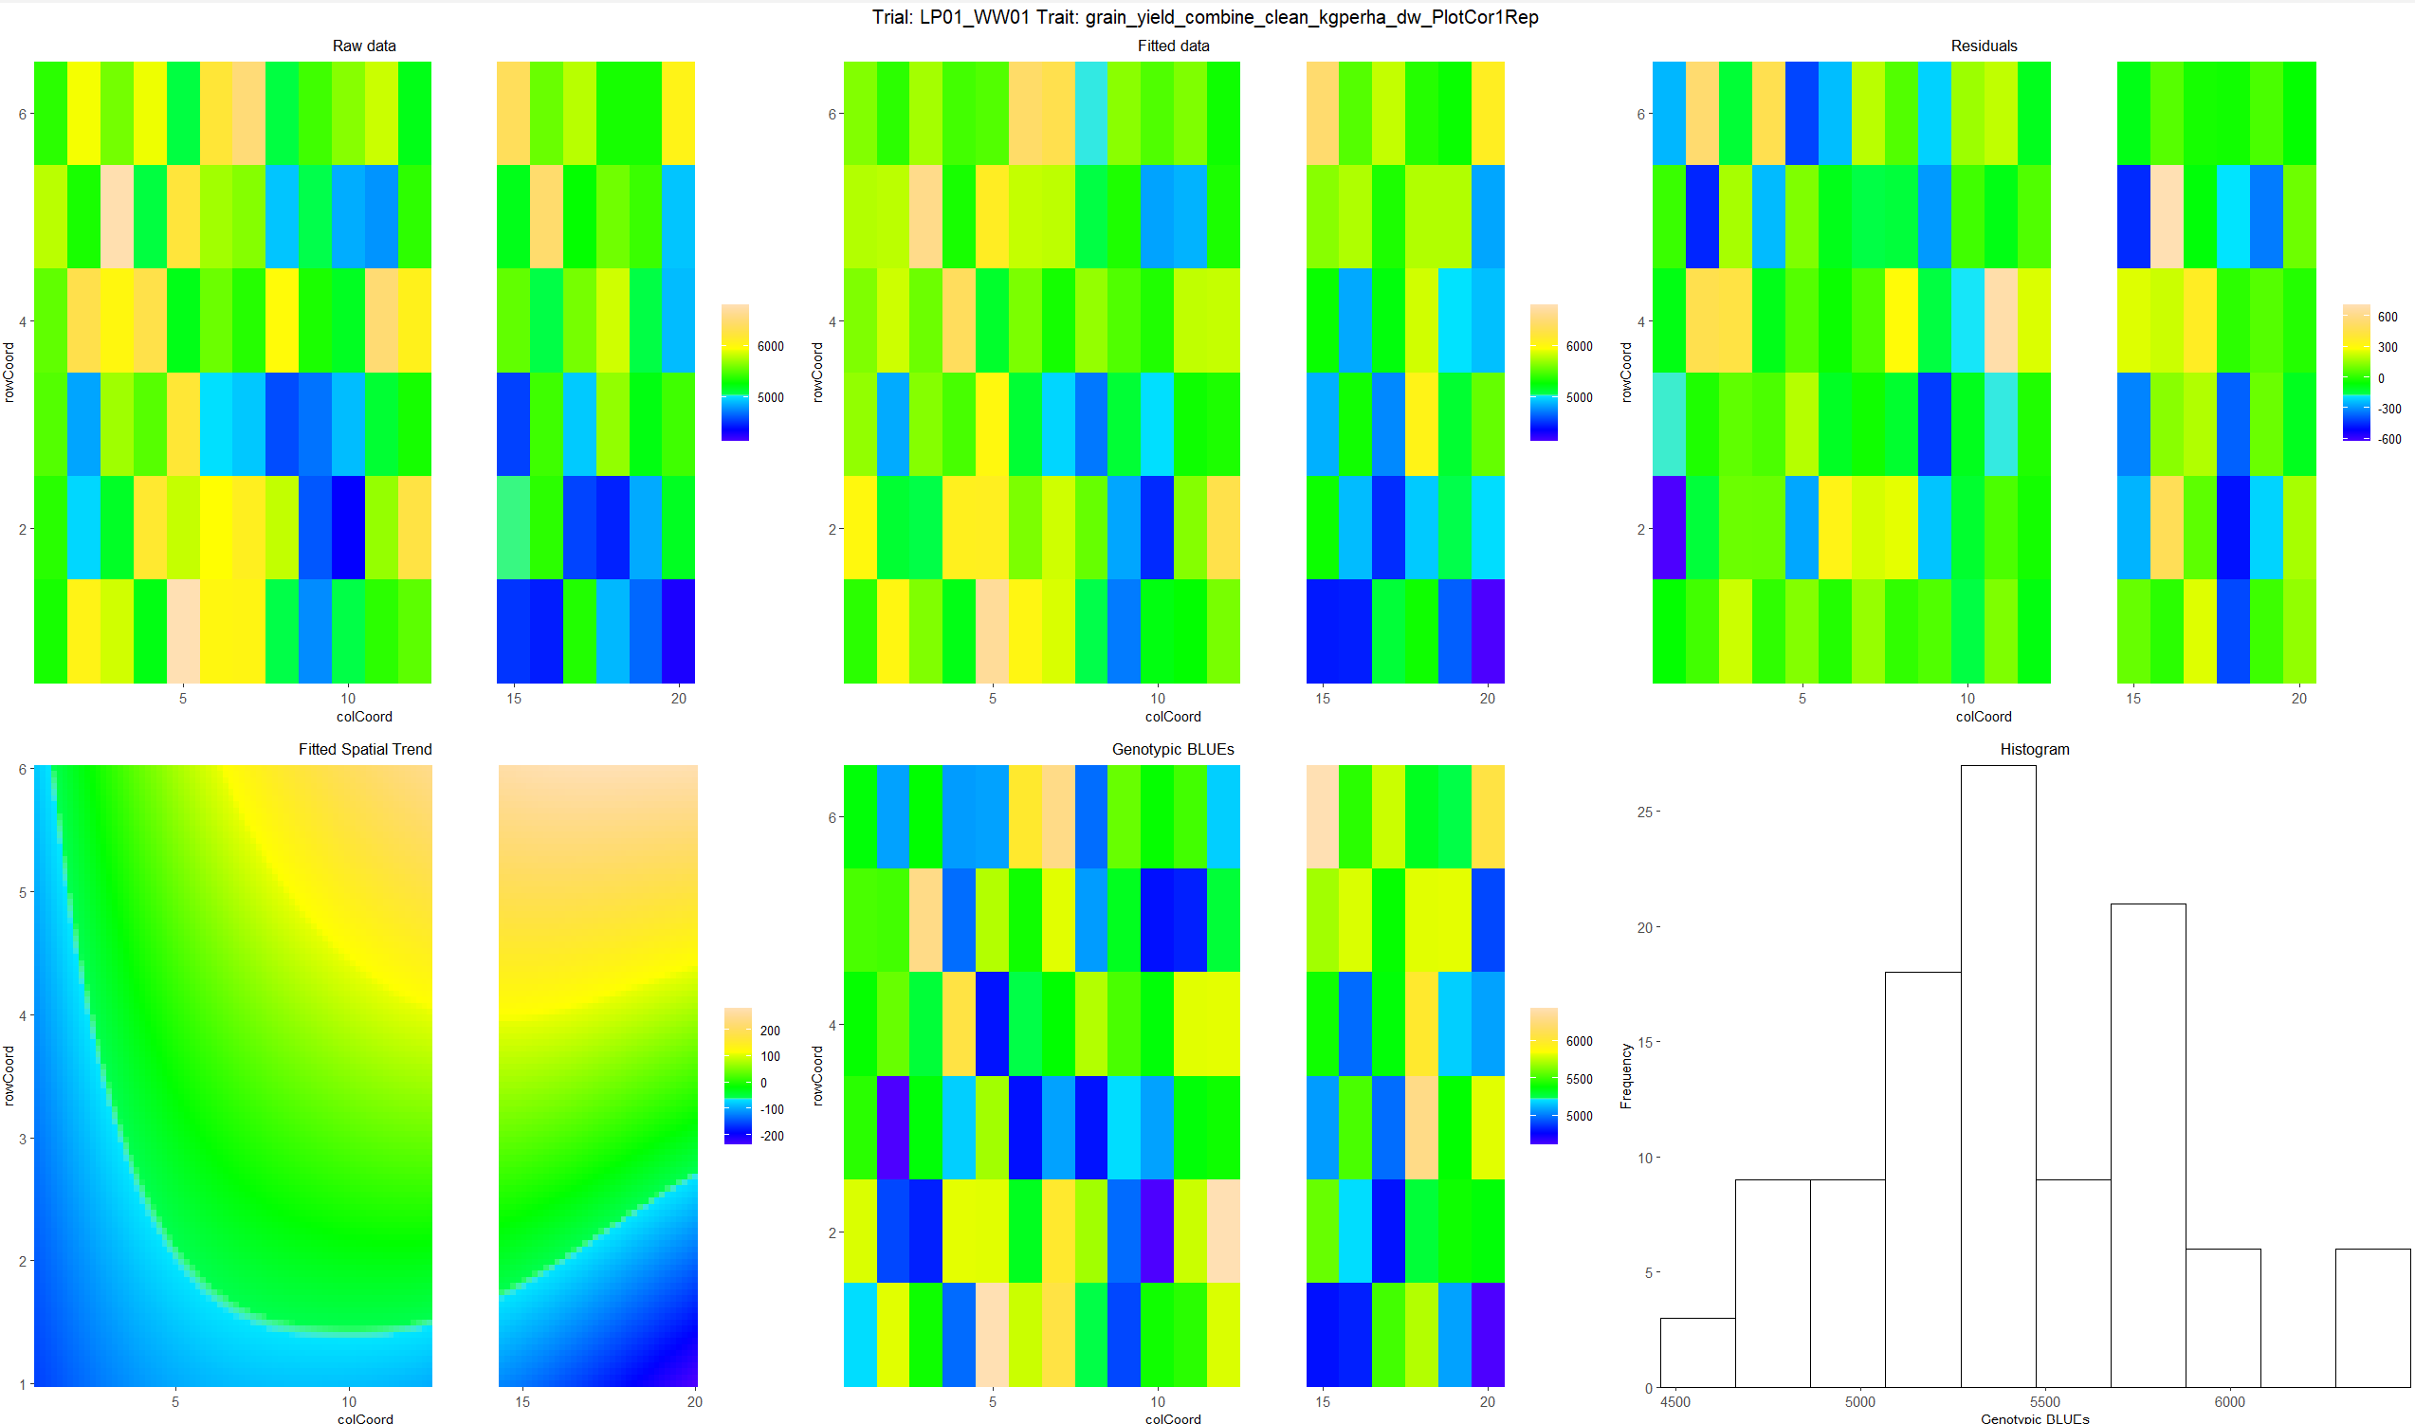
Conventional N – 2023 – h2 = 0.89 (0.91: without plot cor; 0.94: 10 Var )

Slide 27


N0 – 2024 – h2 = 0.84 (0.87: without plot cor; 0.85: 10 Var )

Slide 28


N reduced– 2024 – h2 = 0.94 (0.93: without plot cor; 0.91: 10 Var )

Slide 29


Conventional N – 2024 – h2 = 0.94 (0.91: without plot cor; 0.98: 10 Var )

Slide 30


Impact of spatial correction over years
Before correction
After correction

Slide 31

Impact of spatial correction over years
Before correction
After correction

Slide 32


Impact of spatial correction over years: N0
Before correction
After correction

Slide 33


Impact of spatial correction over years: conventional N
Before correction
After correction

Slide 34


N0 analysis: 2021
Before correction
After correction

Slide 35


Conventional N analysis: 2021
Before correction
After correction

Slide 36


N0 analysis: 2022
Before correction
After correction

Slide 37


Conventional N analysis: 2022
Before correction
After correction

Slide 38


N0 analysis: 2023
Before correction
After correction

Slide 39


Conventional N analysis: 2023
Before correction
After correction

Slide 40


N0 analysis: 2024
Before correction
After correction

Slide 41


Conventional N analysis: 2023
Before correction
After correction

